Slide 1
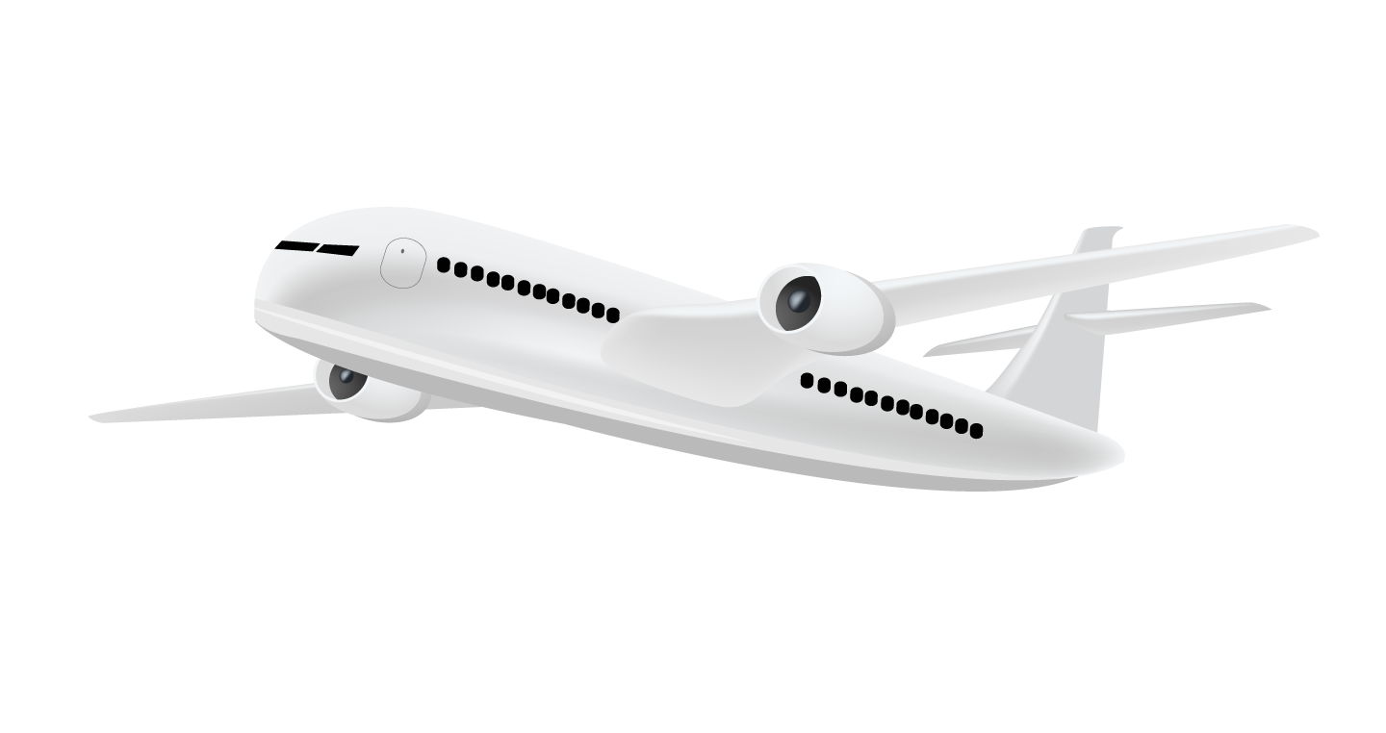
Passenger Satisfaction Analysis
Passenger Satisfaction Analysis to Identify Service Improvement Priorities in the Airline Industry
DATASET | COLAB NOTEBOOK | PBI FILE
By Akmal Zuhdy Prasetya
Bootcamp Data Analytics & Business Intelligence Batch 19+
dibimbing.id
April, 2026

Slide 2

Contents
01
02
03
04
05
06
Dataset Overview
Analysis Method
Data Preparation
Dataset Acquisition & Profiling
Business Problem Identification & Analytical Method
Data Cleaning & Feature Engineering
EDA
Business Insight Summary
Business Recommendation
Data Analysis & Insights
Key Business Insights
Data-driven Recommendations

Slide 3
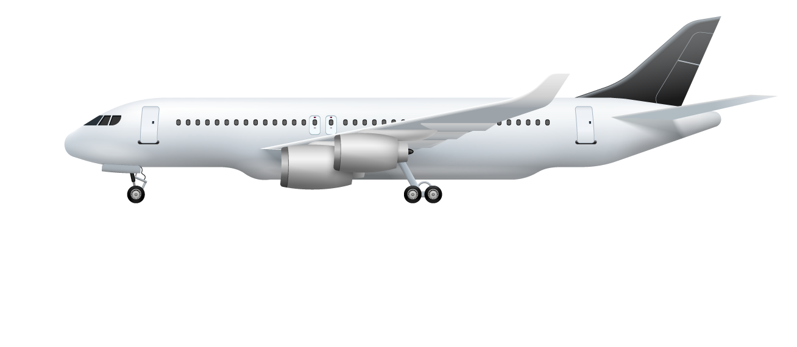
01
Dataset Overview
Dataset Acquisition & Profiling

Slide 4

Dataset Acquisition
Detail Airline Passenger Satisfaction Dataset
Source: Kaggle
Industry: Airline
Total records: 100.000+
Focus: Customer Satisfaction Analysis
Memiliki konteks bisnis yang relevan dalam industri penerbangan.

Slide 5
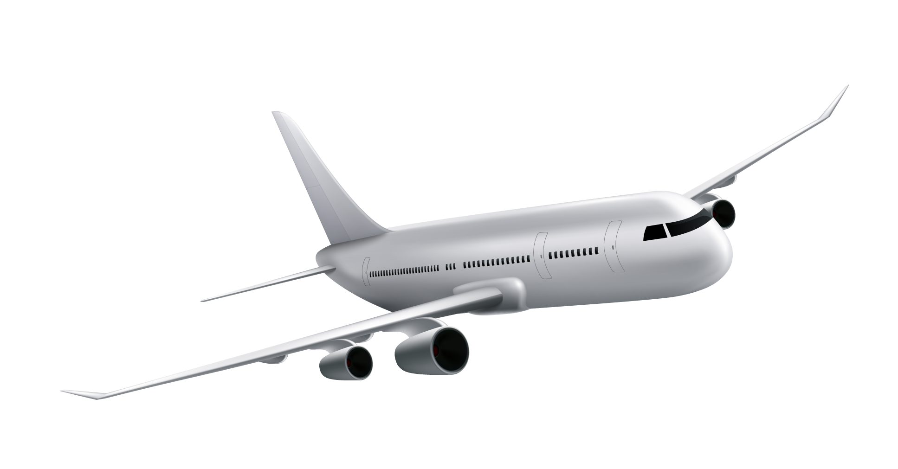
Dataset Profiling
Komponen | Hasil
Rows | 103.904
Columns (Variables) | 25
Missing Values | 310 (Arrival Delay)
Duplicates | 0
Data Types | Numerical & Categorical

Slide 6
02
Analysis Method
Business Problem Identification & Analytical Approach

Slide 7

Business Problem
How can airlines identify the service attributes that most influence satisfaction across different passenger segments to improve service investment decisions?

Slide 8
Business Objectives
01
02
03
Identify key satisfaction drivers
Compare passenger segments
Prioritize service improvements

Slide 9
Analytical Approach
Descriptive Analysis
Melihat distribusi kepuasan, profil penumpang, dan pola layanan.
Comparative Analysis
Membandingkan business vs personal traveler serta economy vs business class.
Correlation Analysis
Menilai hubungan service rating ↔ satisfaction serta delay ↔ dissatisfaction.

Slide 10
03
Data Preparation
Data Cleaning & Feature Engineering

Slide 11
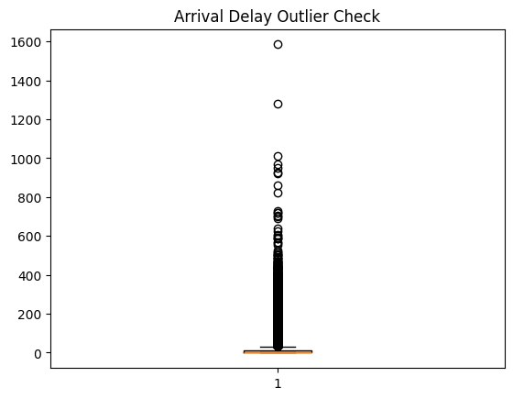
Missing Value Handling
Missing values pada arrival delay diimputasi menggunakan median untuk menjaga robustness terhadap outlier dan distribusi yang skewed.

Slide 12
Feature Engineering
Delay Category
Service Score
Segmentation
Kategorikan Delay menjadi No Delay, Minor, dan Major.
Agregasi dari beberapa atribut layanan.
Penggabungan tipe perjalanan dan kelas.

Slide 13

04
EDA
Data Analysis & Insights

Slide 14
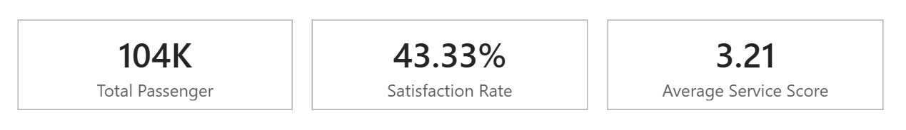
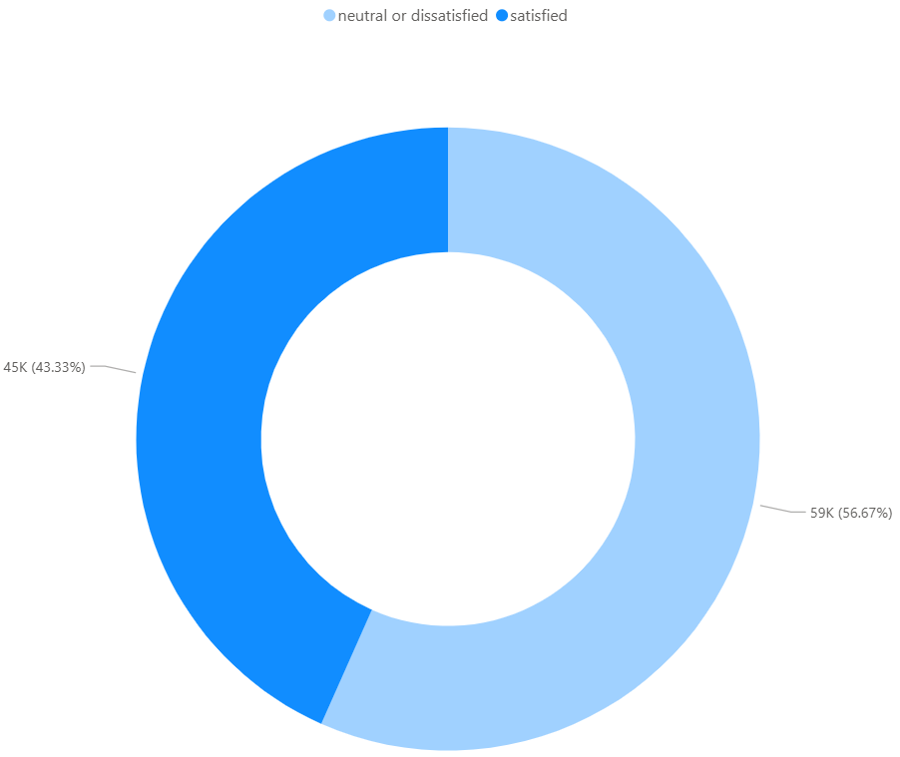
Satisfaction Overview
Recorded Passengers
Total passengers analyzed: 103,904
Satisfaction (%)
43% of passengers are satisfied and 57% are neutral or dissatisfied
Average Service Score
Average rating score of all service type is 3.21

Slide 15
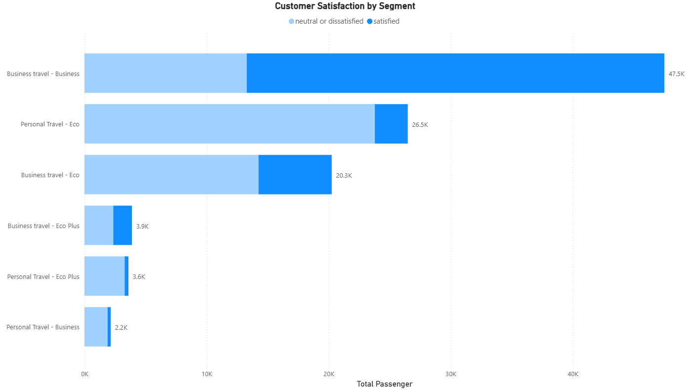
Customer Satisfaction Varies Significantly Across Segments
01
Business travelers in business class show the highest satisfaction level
02
Personal travelers in business segments show the lowest satisfaction
03
Significant variation indicates different customer expectations across segments

Slide 16
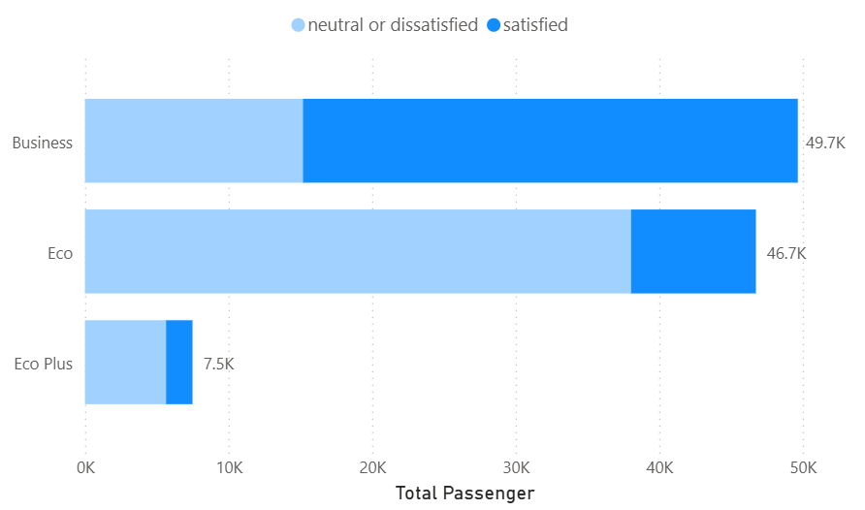
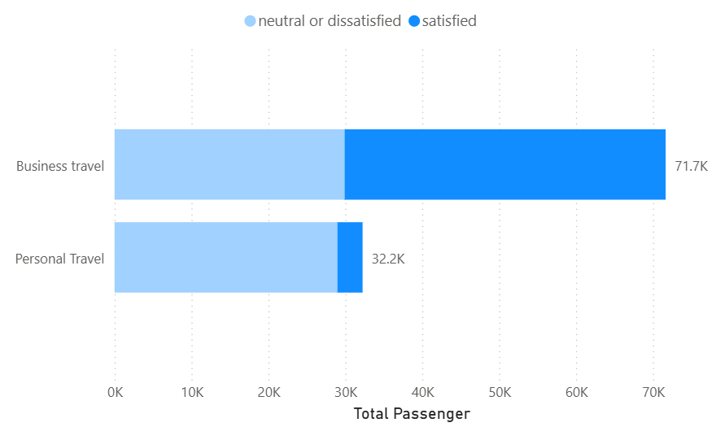
Travel Type and Class Strongly Influence Satisfaction
01
Business travelers tend to have higher satisfaction than personal travelers
02
Business class passengers show significantly higher satisfaction than economy class
03
Travel type and class are key differentiators in customer experience

Slide 17
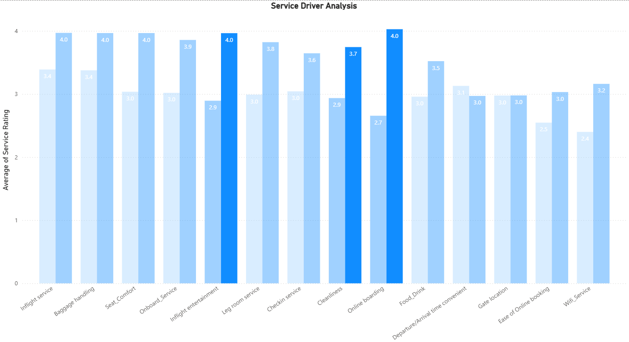
Service Quality Strongly Influences Customer Satisfaction
01
Higher service ratings are associated with higher satisfaction
02
Key service attributes with strong impact include: Inflight entertainment, Cleanliness, and Online boarding.
03
Indicates that service quality plays a critical role in shaping customer experience

Slide 18
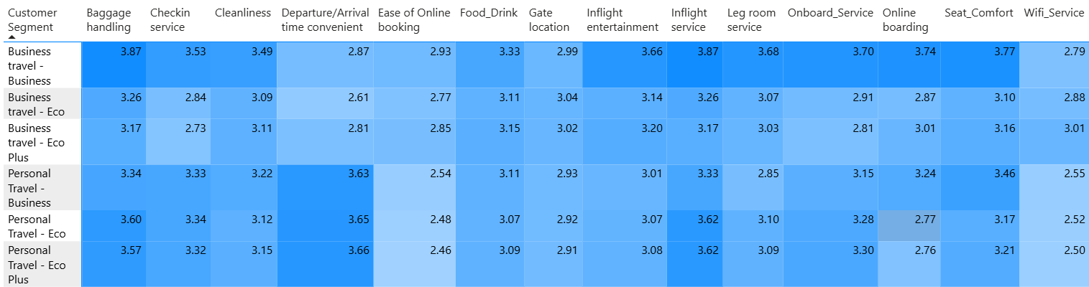
Different Customer Segments Value Different Services
01
02
03
Business travelers show strong differences in service ratings between satisfied and dissatisfied groups
Personal travelers show relatively small differences across service attributes
Indicates varying sensitivity to service quality across segments

Slide 19
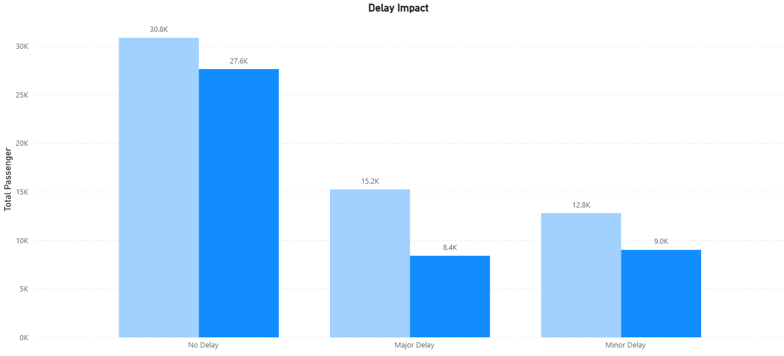
Flight Delays Affect Satisfaction, But Are Not the Primary Driver
01
02
03
Increased delay is associated with lower satisfaction
However, the impact is smaller compared to service quality and class differences
Delay contributes to dissatisfaction but is not the dominant factor

Slide 20
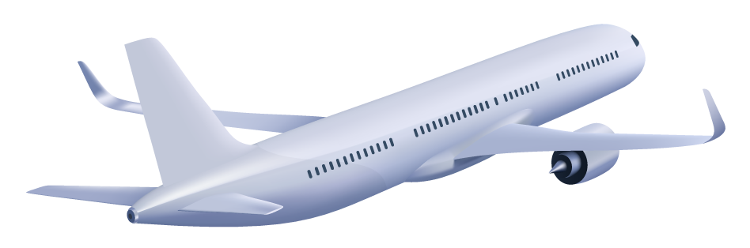
05
BUSINESS INSIGHT SUMMARY
Key Business Insights

Slide 21
Key Business Insights
Segment-Driven Satisfaction
Service as a Primary Driver
Low Sensitivity in Personal Segment
Customer satisfaction is highly dependent on passenger segment, with significant gaps across travel type and class
Service quality is a strong driver of satisfaction, particularly for business travelers
Personal travelers show relatively low sensitivity to service improvements

Slide 22
Key Business Insights
Different Needs Across Segments
Delay as a Secondary Factor
Service attributes do not have equal impact across segments, indicating different customer priorities
Flight delays negatively affect satisfaction but are not the primary determinant

Slide 23
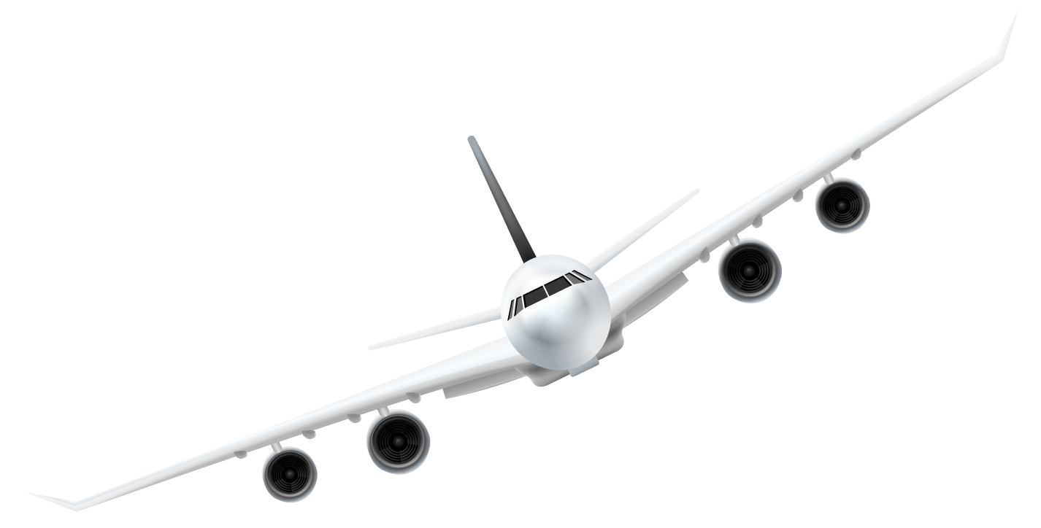
06
BUSINESS RECOMMENDATION
Data-driven Recommendations

Slide 24
Prioritize High-Impact Segments
Leverage High-Satisfaction Business Segment
Address Low-Satisfaction Economy Segments
Business travel - Business shows the highest satisfaction (~72%), indicating strong response to service quality. Maintain and enhance premium experience to retain high-value customers
Personal Travel - Eco and Eco Plus show extremely low satisfaction (<20%). Target these segments for improvement to reduce dissatisfaction at scale

Slide 25
Focus on High-Impact Service Attributes
Prioritize Inflight entertainment, Cleanliness, and Online boarding
Differentiate Secondary Services
These attributes show the largest rating gap (~0.8–0.9) between satisfied and dissatisfied customers. Improving these areas is most likely to increase satisfaction.
Attributes such as food and wifi show smaller or segment-specific impact. Optimize rather than heavily invest across all segments.

Slide 26
Apply Segment-Specific Service Strategy
Enhance Service Quality for Business Travelers
Re-evaluate Strategy for Personal Travelers
Strong rating gaps across all service attributes indicate high sensitivity. Service improvements will directly increase satisfaction.
Minimal rating differences and observed inconsistencies suggest service is not the primary driver. Investigate alternative factors (e.g., pricing, expectations, travel purpose)

Slide 27
Improve Operational Reliability Strategically
Reduce Major Delays to Prevent Dissatisfaction
Balance Operational vs Service Investment
Satisfaction drops from ~47% (no delay) to ~35% (major delay). Delay reduction helps prevent negative experiences.
Delay impact exists but is smaller than service and segment factors. Prioritize service improvements while maintaining operational efficiency.

Slide 28

Thanks!

